Slide 1
BE HERE NOW!
the Basis of Reflective Practice
Dr. Kathleen Quinn
May 9, 2017

Slide 2
Review intersecting circles and Johari window

Slide 3
Cultivating attention
“ The faculty of voluntarily bringing back a wandering attention, over and over again, is the very root of judgment, character, and will…An education which would improve the attention faculty would be THE education par excellence. But it is easier to define this ideal than to give practical directions for bringing it about,” William James from Talks With Teachers (1899)

Slide 4
Really quickly think:
How have I been mindLESS today?
And what happened because of this?

Slide 5
“Our genome reflects a range of potential
And waits for direction from the environment….
We create the earth and the earth creates us.”
Nathan Daley

Slide 6
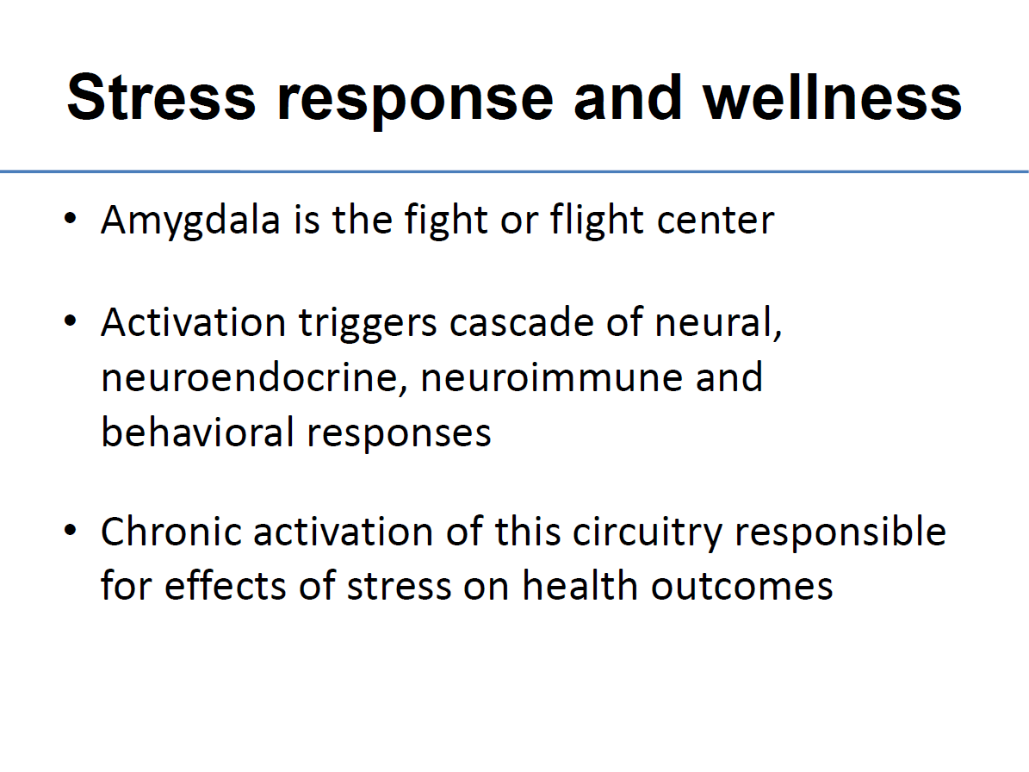
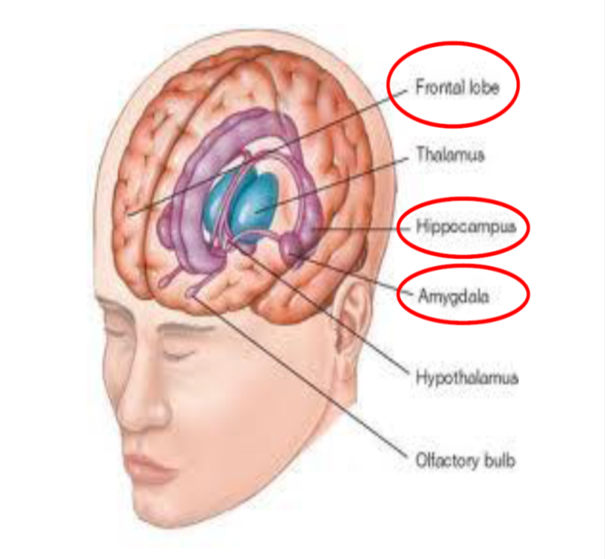

Slide 7
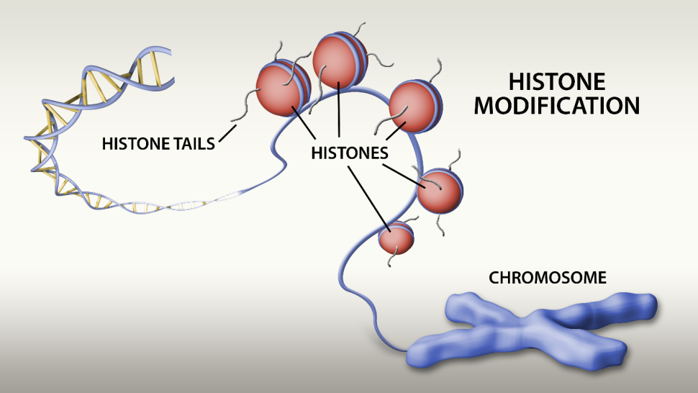
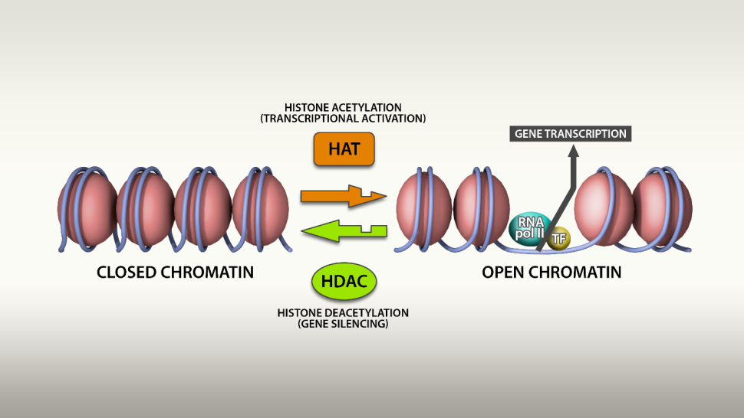
This is how stress affects epigenetic switching

Slide 8
Neuronal Activity is stimulated by internal states and external stimuli….
"The problem is that both neurons and the complicated organic molecules in each neuron are pretty complex in their own right; their behavior depends in subtle ways on the specific inputs they are receiving from their environments."
The Big Picture: On the Origins of Life, Meaning, and the Universe Itself" by Sean Carroll
the brain changes itself in response to input…this is how learning, and situational growth happens.

Slide 9
Communication of Fear Non-Verbally Across Groups
"We are extremely sensitive to emotional body language, and we react to it without us being aware of it, this puts us in a position to act.” (Beatrice M.L. de Gelder, Harvard. 2008)

Slide 10
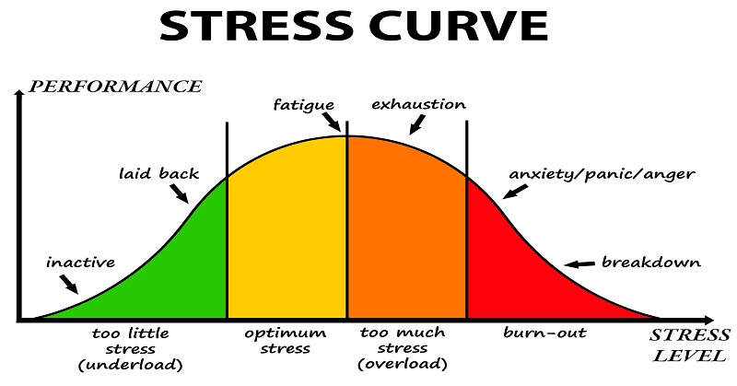

Slide 11

Mirror neurons and learning

Slide 12
Mirroring
Mirror neurons may thus facilitate the preliminary motor neuron simulation, priming, programming, and rehearsing that occurs in children, and this process obviously enhances our eventual mastery of complex motor behaviors, and our ability to read the minds of others.

Slide 13
Indeed there is clear evidence that mirror neuron system is involved both in immediate repetition of actions done by others (Iacoboni et al. 1999) and in imitation learning (Buccino et al. 2004).

Slide 14
Empathy - emotions
Mirror neuron network in man involves and activates Amygdala (emotions)
We do not accomplish understanding of other’s feelings by analogy or thinking processes.
Rather, the other’s emotion is experienced by ourselves and therefore directly understood. It is a shared body state.

Slide 15
Tennessee Williams quote: “Nobody sees anybody truly, but through the flaws of their own ego.”

Slide 16
Definition of Mindfulness
Mindfulness means maintaining a moment-by-moment awareness of our thoughts, feelings, bodily sensations, and surrounding environment. Without judgment…accepting what is within and without in this moment. It slows the process down so we can observe, think, respond in a compassionate caring manner.

Slide 17

What would you use mindfulness for?
Listening, really listening
Being here with students, patients, colleagues
Turning conflict into a teaching/useful moment
Avoiding medical errors
Teaching at optimum levels
Depth learning
Creating positive, peaceful learning environments
Building compassionate schools and healthcare programs
Managing stress
Maintaining wellness
Developing leadership
Forming fully functioning groups
Teaching others to help themselves….the ripple effect!

Slide 18
Executive function
The collective neurological functions controlling:
Goal directed behavior
Planning
Organized search
Impulse control
All of these are correlated to working memory, emotional regulation and resilience

Slide 19
This concept and exercise of Mindfulness is…
The first step in Deliberate Practice
Reflective Practice
Intentional Teaching
AND Mastery acquisition in all healthcare clinical experiences, sports, teaching, etc.

Slide 20
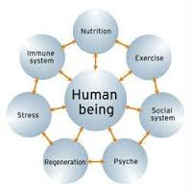
The process of mindful interactions ALWAYS:
Begins with the SELF first…
Requires self AWARENESS
Begins with the other second…
Uses mirror neurons to observe
Body Scan to sense self and other communication mirroring and then engaged interactions with others
Then returns to self for awareness of changes in any area of life.

Slide 21
Three things necessary for engaging with diverse individuals
Empathy
Compassion
Kindness
From the parents tool kit.

Slide 22
BEING AWAKE AND AWARE! How do we wake up?

Slide 23
Let’s try one
Do the tighten up!!!

Slide 24
Stress Management Benefits Using Mindfulness Techniques
For Faculty
Decrease overall psychological distress
Decrease stress,
Decrease job burnout
More compassionate interpersonal relationships
Increased awareness
For Students
Increased learning ability and memory retention
Reduced anxiety
Actually increased test grades
Enhanced performance in skills
More compassionate interpersonal relationships
Increased Awareness

Slide 25
This is the basis of Psychoneuroimmunology
Under stress the brain changes itself and the body
Under mindful stress management the brain intentionally changes itself and the body

Slide 26
Let’s do a quick body scan

Slide 27
“The universe is a continuous web. Touch it at any point and the whole web quivers.”
Stanley Kunitz

Slide 28

Into A Place of Serenity for a Moment
You can use a desktop picture for imagery
Or
Use the body scan…
Or go to your chest… ask what am I feeling?
Deep breath...relax the chest and back…
And/Or imagine a hot white light in the chest.

Slide 29
“We do not see the world as it is, but as we are.”
Anais Nin

Slide 30
Mindfulness and
Professional Practice
What happens to our own practice and teaching if we are attentive to ourselves and others?
What happens if we slow the process down?
Talk less?
Listen more?
Laugh harder?☺

Slide 31
We all have something we do every day many times
Teachers, nurses, doctors, administrators…we all are on the run.
Soooooo, use something that happens all the time as the signal to center and focus, be aware and paying attention…
Going through a door, phone ringing, student raising a hand….make the thing you do most the signal for mindfulness…

Slide 32
When you put it all together:
Check your:
Posture—what is my body saying, doing?
Attitude—what am I feeling, thinking?
Breath—how am I breathing or not?
Let go---let go--focus

Slide 33
What the research shows
Beginning every class with a mindfulness moment….a one minute mindfulness exercise…improves students grades (Youmans & Ramsberg, 2014)
Doing a one minute paragraph at the end of class stimulates short term recall, reinforces learning and informs faculty about what worked, what didn’t, and where additional emphasis needs to be placed. ( developed at Stanford University)

Slide 34
☺
“we are what we are because of stresses placed upon us and the adaptations we have made to these stresses both physical and otherwise. The state of our bodies, our minds, and our personalities is the result of these adaptations”
(Counsilman, 1968, p. 349, italics in original)
Are you holding your breath right now?
Exhale slowly….
Have a lovely afternoon!

Slide 35
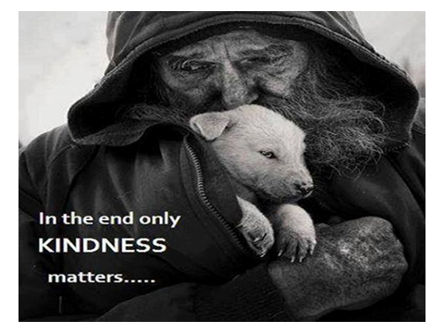

Slide 36
Additional references slides containing the work of:
Giacomo Rizzolatti et al. Premotor cortex and the recognition of motor actions. Cognitive Brain Research 3. 1996:131-141
Giacomo Rizzolatti et al. Motor and cognitive functions of the ventral premotor cortex. Current Opinion in Neurobiology 2002, 12:149–154
Stolorow, R. D. & Atwood, G. E. (1992) Contexts of Being: The Intersubjective Foundations of Psychological Life. Hillsdale, N.J.: The Analytic Press.)
Trevarthen, C. & Aitken, K.J. (2001) Infant intersubjectivity: research, theory, and clinical application. Journal of Child Psychology & Psychiatry. Vol. 42 (1)
Beatrice M.L. de Gelder, Harvard. 2008
Xuan Zhao
Julie Summers and T.J. Koomen

